Slide 1
Learning in the agora: the new engagement agenda in science
Frans Berkhout
King’s College London
and
Future Earth

Slide 2
Outline
The problem
Antecedents
Dimensions of engagement
What we are doing in Future Earth
Questions to you

Slide 3
The problem
The co-production idiom and science policy
Instrumentalism in science policy
The ‘knowledge democracy’
But how should we do it?
What are the new risks and how are they managed?

Slide 4
Precursors I
Lubchenco (1998)
‘…a commitment on the part of all scientists to devote their energies and talents to the most pressing problems of the day’

Slide 5
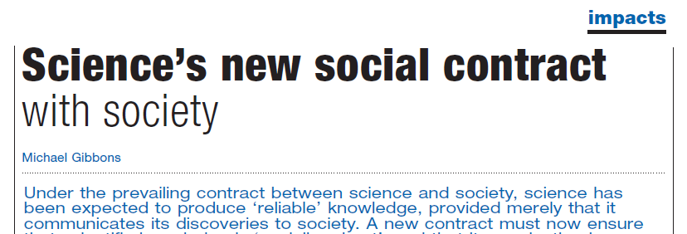
Precusors II
Gibbons (1994, 1999), Nowotny et al (2001)
Reliable knowledge to socially-robust knowledge
Science produced in open systems of knowledge production (the agora)
Uncertainty

Slide 6
The four processes
Co-evolution
Contextualisation
Production of socially-robust knowledge
Narratives of expertise

Slide 7
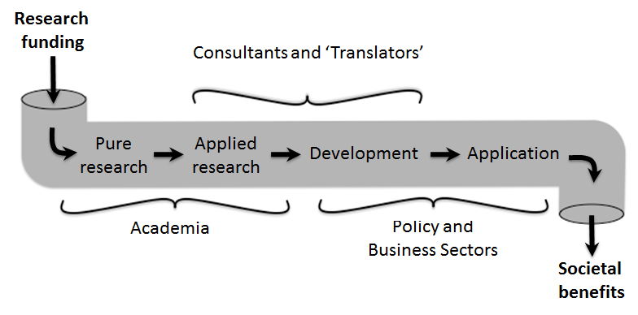
The ‘linear model’ of science and society

Slide 8
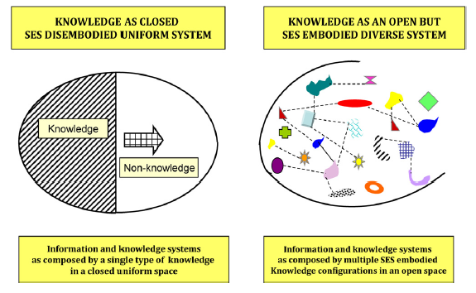
Two visions of knowledge systems

Slide 9
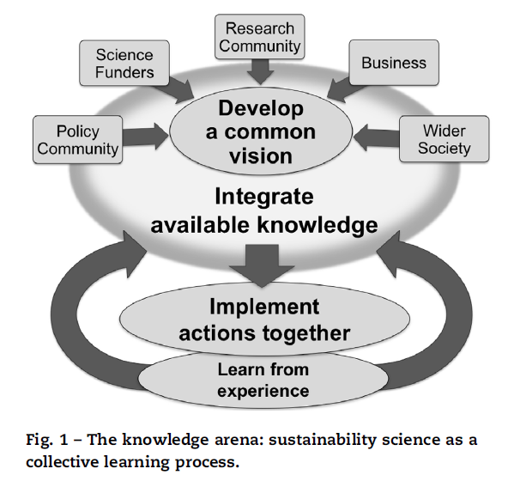
Source: Cowell et al, 2013
Co-design and co-production of knowledge

Slide 10
Co-production
‘…the collaborative process of bringing a plurality of knowledge sources and types together to address a defined problem and build an integrated or systems-oriented understanding of that problem.’
Armitage et al. (2011)

Slide 11
Phases in co-production
Joint problem-framing
Integration in knowledge production
Collaborative experimenting and learning

Slide 12
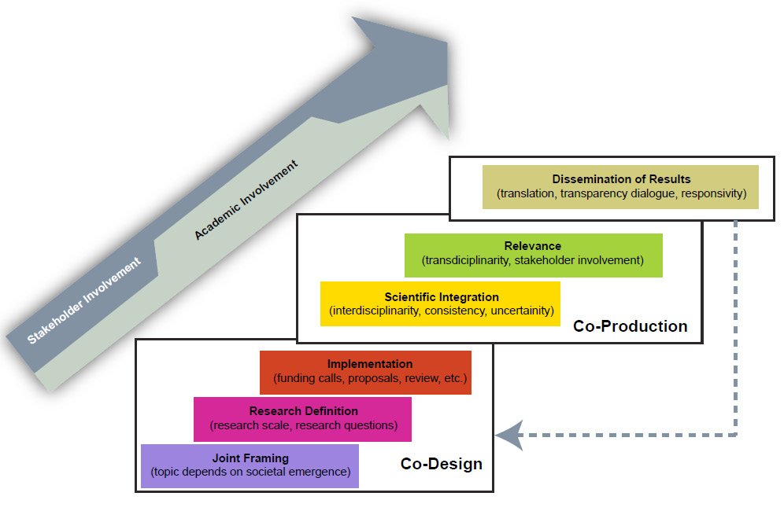
Source: Mauser et al., 2013

Slide 13
Framing agoras
Plurality (inclusivity, who?)
Positioning (expertise, power)
Competences (the how of engagement)
Incentives (benefits and costs to actors)
Arrangements (experiments, mediating relationships across boundaries)
Valuing outcomes (metrics, measurement)

Slide 14
Pioneers
Agricultural extension
Development studies
(Translational) medicine

Slide 15
Future Earth
A global platform for international scientific collaboration
Enables integrated research on grand challenges and transformations to sustainability
Strengthens global partnerships between researchers, funders and partners of research
Communicates science to society and society to science

Slide 16
Objective
To build the knowledge required for societies in the world to face risks posed by global environmental change and to seize opportunities in a transition to global sustainability

Slide 17
Two key aims
Scientific integration
Joint knowledge production

Slide 18
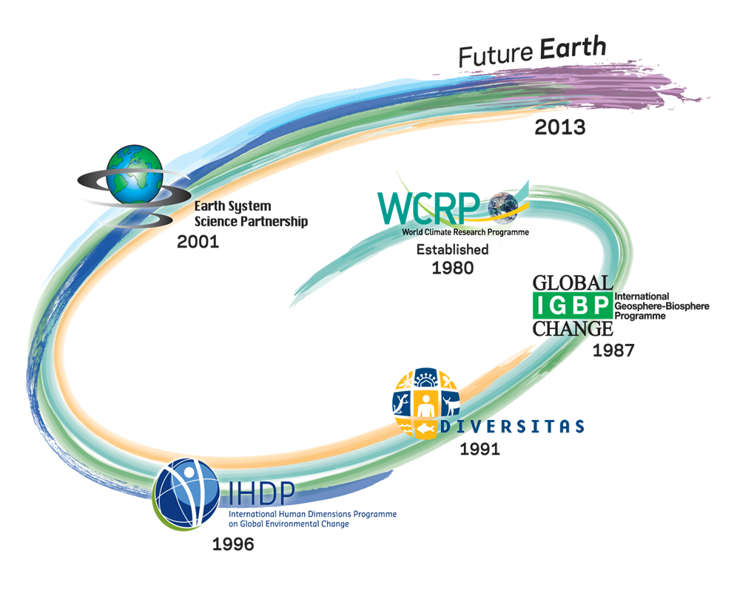
An integrated programme

Slide 19
Future Earth: structure
Project
Project
Project
Future Earth Council
Project
Science
Committee
Engagement
Committee
Project
Project
Secretariat
Project
Project
Project

Slide 20
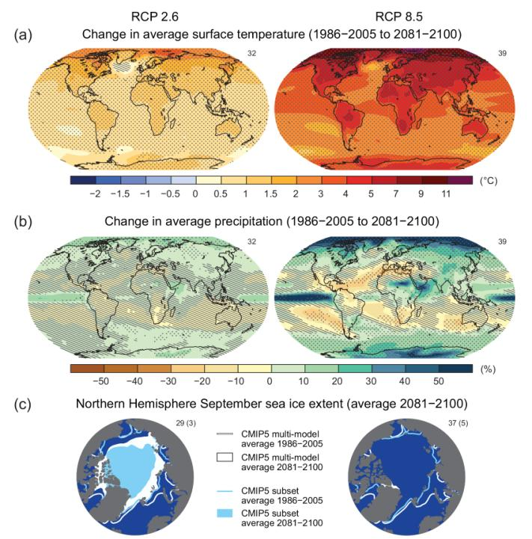
Current engagement
IPCC Climate model inter-comparisons (CMIP5)
AR5 WG1 SPM - Global surface temperature change for the end of the 21st century is likely to exceed 1.5°C relative to 1850 to 1900 for all RCP scenarios except RCP2.6. It is likely to exceed 2°C for RCP6.0 and RCP8.5, and more likely than not to exceed 2°C for RCP4.5. Warming ….will not be regionally uniform

Slide 21
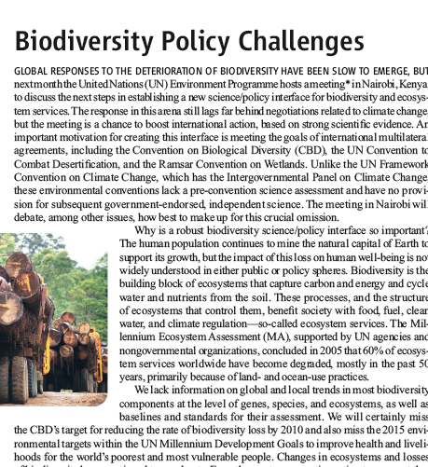
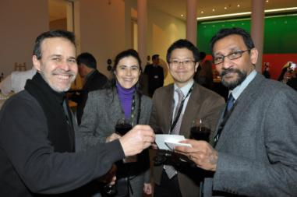
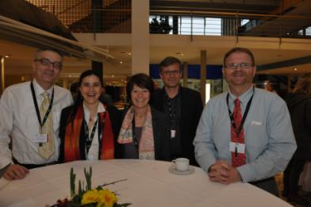
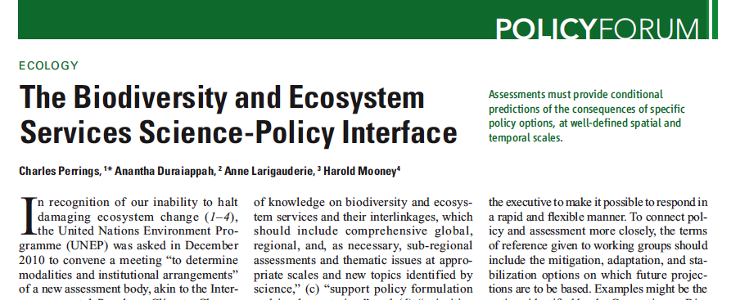
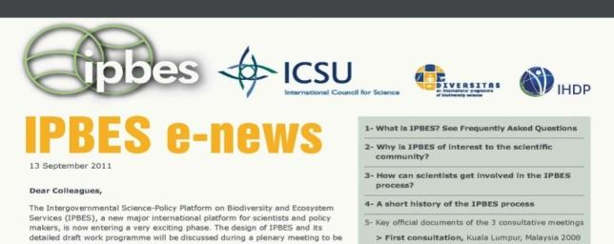
Current engagement
Intergovernmental Platform on Biodiversity and Ecosystem Services

Slide 22
Plurality
Structured representativeness (governance and activities)
Search for new partners (new funders, business)
Awareness of the need to work beyond the global level alone

Slide 23
Positioning
Excellence of science (conventionally defined)
Encouraging self-organisation (what ‘works’ for the problem/setting)
Uncertainty about quality (who judges? what criteria? over what period?)

Slide 24
Competences
Communicating/translating/moderating
Creating arenas
Dialogic processes
Listening, bridging, integrating

Slide 25
Incentives
Considering costs/risks of engagement for researchers and partners in co-production
Staged funding models
Building capacities for transdisciplinarity (on all sides)

Slide 26
Arrangements
Designing open, more experimental contexts for knowledge production (global, local, multi-level)
Institutionalising more stable relationships between partners in knowledge production (funding, boundary organisations)

Slide 27
Outcomes
Valuing and measuring impact (of co-production and of science within this)
Valuing the process (learning, innovation)

Slide 28
Objections to engagement
Fears of researchers
Bias due to undue influence of money or decision-makers
Constraints on academic freedom
Exposure of poor understanding of decision-making or practice context – embarrassment

Slide 29
Objections to engagement
Fears of funders
Loss of control over decision-making on research priorities, proposals
Fears of societal partners
Time sink for irrelevant research
Too much information too late for the policy process
Value of public knowledge
Use of results in intended and unintended ways

Slide 30
Some questions to you
Is the analysis right?
Who should we be learning from?
Where are the greatest opportunities for a global programme like Future Earth?
What are the most important pitfalls?

